Slide 1


Slide 2
What is raspberry pi ?
A low cost, credit-card sized computer that plugs into a computer monitor or TV, and uses a standard keyboard and mouse.
Program languages it uses are Scratch and Python.
Capable of doing everything you’d expect a desktop computer to do, from browsing the internet and playing high-definition video, to making spreadsheets, word-processing, and playing games.

Slide 3
Developers…
Developed in U.K. by Raspberry - Pi foundation in 2009
Concept Initiated by Eben Upton who works at Broadcom
Supported by “University of Cambridge Computer Laboratory & Broadcom”
To promote the study of basic computer science in schools & to develop interest among kids and adults

Slide 4
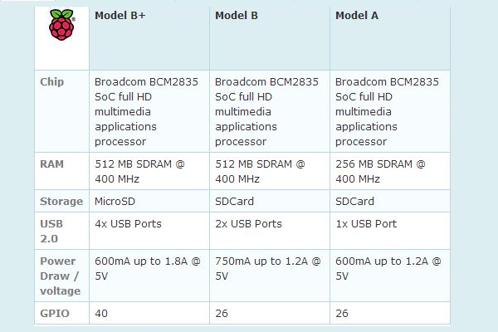
Raspberry pi- Models

Slide 5
Specifications
Broadcom BCM2835 SoC
CPU: 700 MHz ARM11
GPU: Open GLES 2.0,1080p H.264 encode/decode
GPIO,SPI,I2C,I2S,UART
SOC-System on a chip, A computer on a single chip with low voltage consumption.
Video Input : Camera Support via CSI Connector
Video Output : Composite Video (RCA) or HDMI or LCD Support via DSI

Slide 6
Specifications
Networking : 10/100 Mbit/s Ethernet Support on Model B/B+
Audio Outputs : 3.5 mm Jack
I.O. Lines : 26 Pin GPIO Connector on Model A/B and 40 Pin GPIO Connector on Model B+ (GPIO, UART, SPI, I2C, Power Rails, I2S, etc)
Power Source : 5V/2A DC Adapter via Micro USB

Slide 7
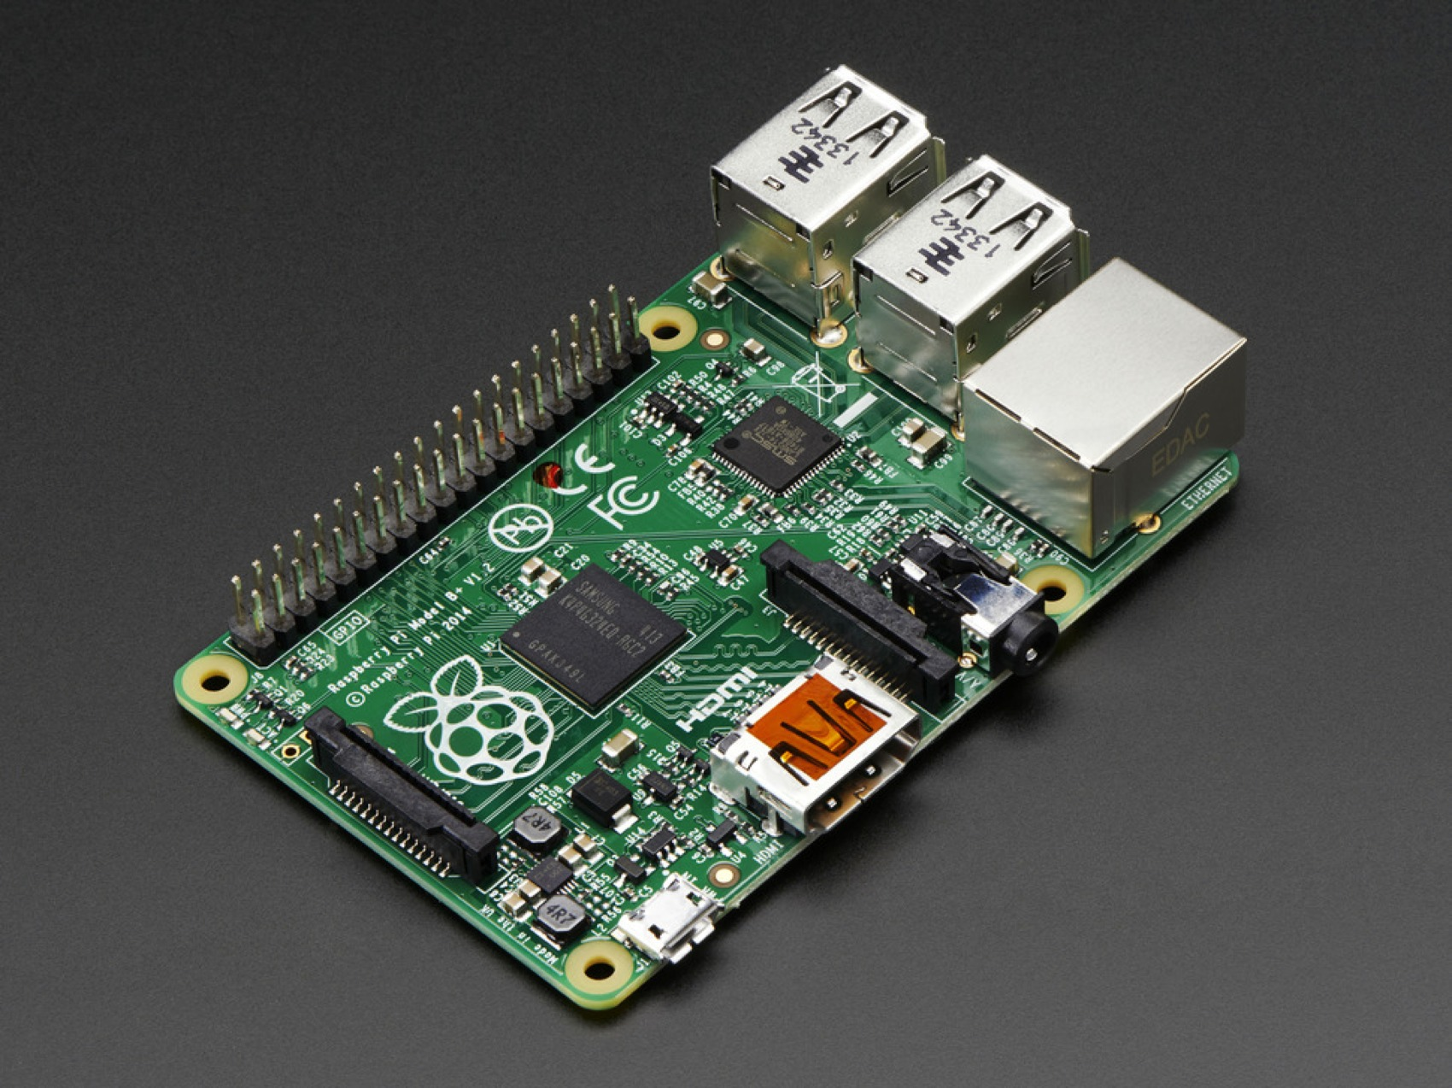
System on chip
Combination of required electronics circuit of various computer components onto a single, integrated chip.
Its components usually include a graphical processing unit (GPU), a central processing unit (CPU) that may be multi-core, and system memory (RAM).
It includes both hardware and software, so-
It uses less power
Requires less space
More reliable
It has analog, digital, mixed signal and radio frequency function.

Slide 8
Requirements on bench
Raspberry Pi
Power supply: 5v 1A wall wort
USB A,USB B micro
SD card:4Gb class 4
SD card Reader
Powered USB Hub
USB WiFi Adapter
USB Keyboard and Mouse
RCA or HDMI cable
3.5 Audio(RCA Adapter)
IR Remote, Web cam
Bread board, ICs, Resisters, LEDs, Wires, Switches, Sensors, etc

Slide 9
Operating System
Official from raspberrypi.org
NOOBS
Raspbian Wheezy: Debian optimized for Raspberry pi raspbian.org
“Soft Float” raspbian Wheezy available if you want to run java
Un Official
Adafruit Occidentallis : Raspbian+ support for GPIO,I2C,etc
RaspBMC: XBMC port

Slide 10
Raspberry pi vs PC
component | Laptop or pc | Raspberry pi ver. B+
Processor | Intel 2.2 GHz, dual core | 700 MHz, single core ARM 11
Ram | 6GB | 512 MB
Graphics | Intel HD 3000 | Dual core video core iv
Ethernet | Yes | Yes
USB 2.0 | Yes | Yes
Video o/p | VGA,HDMI | Composite RCA HDMI
Audio o/p | yes | Yes
Storage | 500 GB hard disk | 32 GB SD CARD
Operating system | Linux/windows | Only Linux
Dimensions | 14 inch laptop | 8.6*5.4*1.9 cm

Slide 11
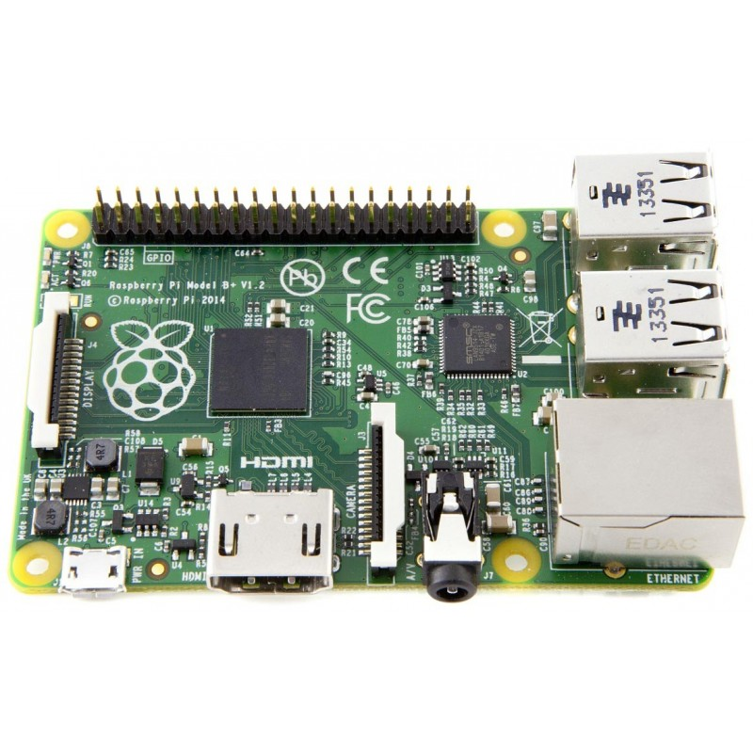
Hardware and connectivity
40 pin GPIO Header
Broadcom BCM 2835 & 512 MB RAM
QUAD USB PORTS
LAN Controller
DSI Display Connector
10/100 Base T Ethernet socket
Micro SD slot
(on underside)
5v micro USB
HDMI Port
CSI camera connector
4 pole 3.5 mm jack

Slide 12
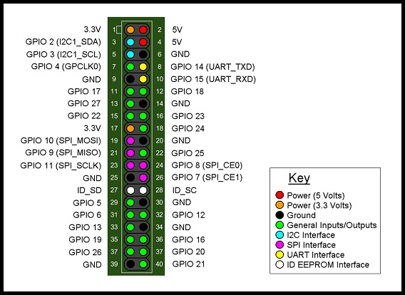
GPIO
GPIO: General purpose Input Output

Slide 13
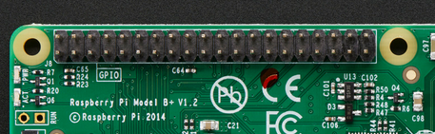
GPIO
GPIO: General purpose Input Output
The 40 pins can be connected to various input and output.

Slide 14
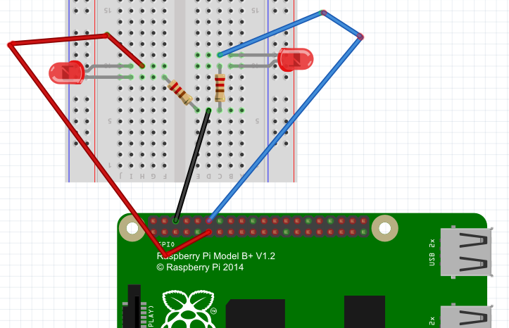
Connection of simple LEDs

Slide 15
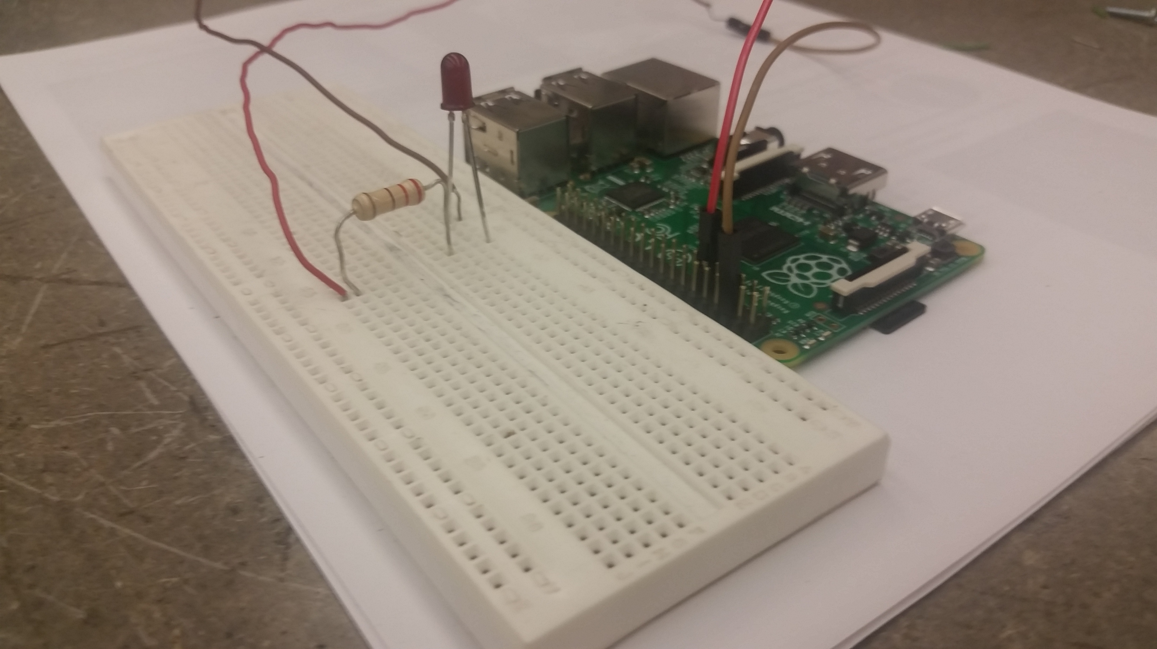
Connection of simple LEDs
Pin 6 for ground
Pin 11 for first LED
Pin 12 for second LED

Slide 16
Preparing a SD card
Format a SD card that is 4GB or larger as FAT. Use the Tool – SDFormatter
Download and extract the NOOBS zip file.
Copy the extracted files into the formatted SD card so that it occupy the root directory of the SD card.
After completion of the process safely remove the SD card and insert it into the raspberry pi and power it up.
A window will appear with a list of options of different operating system to be install. Raspbian is recommended.
Wait for 15-20 min.

Slide 17
First booting
After installation, Raspberry pi configuration menu (raspi-config) will load.
Here we can set time, date, create users or enable a raspberry pi camera board.
Type: startx to enter into graphical environment.
Default login id: pi
password: raspberry

Slide 18
GNU/Linux
Debian based free operating system raspbian is optimized for raspberry pi board.
Debian is one of the most popular Linux distribution or flavour.
GNU/Linux – Free, Open Source, UNIX like Operating System that runs on diverse computing Hardware Platforms.
GNU : Provides the shell, library, compilers
Linux : Provides the Kernel
Examples of Major Free flavours : Fedora, Ubuntu, Mandriva, Suse, etc

Slide 19
Program the Pi
Begin programming of GPIO output using programming language Python.
Python is interpreted, object-oriented and high level programming language.
Included in Raspbian distribution.
To do simple python program to ensure pi is ready to go.
Logon to pi with:
Username – pi
Password - raspberry

Slide 20
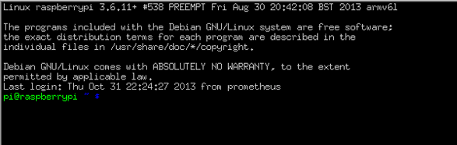
Program the Pi
Appeared cell prompt:
Type Sudo Python: python interpreter will open up
Type quit(): to exit the interpreter
Confirms the python is installed and ready for use.

Slide 21

Program the Pi
First python program:
Open LX terminal
Type sudo nano helloworld.py then press enter
A text editor open up for typing the code
Type print ”helloworld”;
Press CTRL+X then press Y to save the file
To view output type sudo python helloworld.py

Slide 22
Program the Pi
Program to control LED circuit:
Type sudo nano led.py and press enter.
Type the following code on the text editor opened up
import RPi.GPIO as GPIO
import time
GPIO.setmode(GPIO.BOARD)
GPIO.setup(11,GPIO.OUT)
GPIO.output(11,GPIO.HIGH)
time.sleep(1)
GPIO.output(11,GPIO.LOW)
GPIO.cleanup()

Slide 23
Program the Pi
After completing the code press ctrl+x then press Y to save the file.
Now type sudo python LED.py that makes LED to be turned on for 1 sec and then again turned off.
Customize the code to make LED blink for three times.

Slide 24
Program the Pi
import RPi.GPIO as GPIO
import time
GPIO.setmode(GPIO.BOARD)
GPIO.setup(11,GPIO.OUT)
for i in range (0,3):
GPIO.output(11, GPIO.HIGH)
time.sleep(1)
GPIO.output(11, GPIO.LOW)
time.sleep(1)
GPIO.cleanup()
Use of tab instead of space

